Slide 1
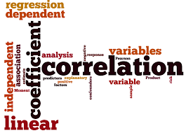
Correlation & Regression
Prepared by:
Reeka Hazarika

Slide 2
Statistical Analysis on Factors influencing Life Expectancy in Developed and Developing countries from year 2000 to 2015

Slide 3
Objectives:
Analysis on factors influencing Life Expectancy in Developed and Developing countries from a period of 2000 to 2015 for 193 countries.
Determine the predicting factors which are contributing to lower value of Life Expectancy.
This will help a country in suggesting which area should be given importance in order to efficiently improve the life expectancy of its population.

Slide 4
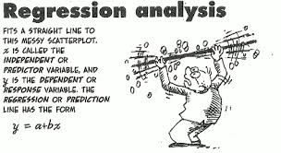
ANALYSIS:

Slide 5
Variables:
DEPENDENT VARIABLE
Life Expectancy in age
INDEPENDENT VARIABLES
Adult Mortality Rates of both sexes (probability of dying between 15 and 60 years per 1000 population)
BMI - Average Body Mass Index of entire population
HIV - Deaths per 1 000 live births HIV/AIDS (0-4 years)
thinness 1-19 years - Prevalence of thinness among children and adolescents for Age 10 to 19 (% )
thinness 5-9 years - Prevalence of thinness among children for Age 5 to 9(%)
Income composition of resources = Human Development Index in terms of income composition of resources (index ranging from 0 to 1)
Literacy Rate - Number of years of Schooling(years)

Slide 6
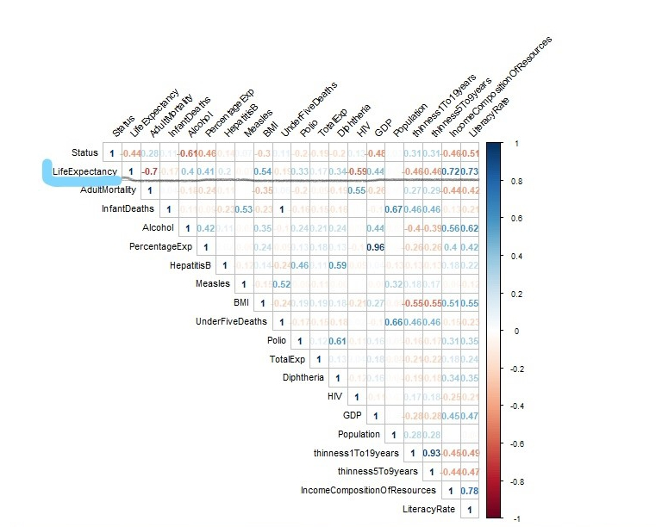
Correlation Coefficient
The size of "r" indicates the strength of the linear relationship between independent(x) and dependent(y) variables
If "r" is near to either +1 or -1, then the linear relationship between x and y is strong.If "r" is near 0 of either sign, the linear relationship between x and y is weak.
Taking into consideration the above details we will consider only the below 7 independent variables to have strong linear relationship with Life Expectancy.
Life Expectancy & HIV – 0.6
Life Expectancy & Income Composition Of Resource – 0.72
Life Expectancy & Literacy rate – 0.73
Life Expectancy & Adult Mortality – 0.7
Life Expectancy & BMI – 0.54
Life Expectancy & thinness5To9years– 0.5
Life Expectancy & thinness1To19years-0.5

Slide 7
Linear Regression Model

Slide 8
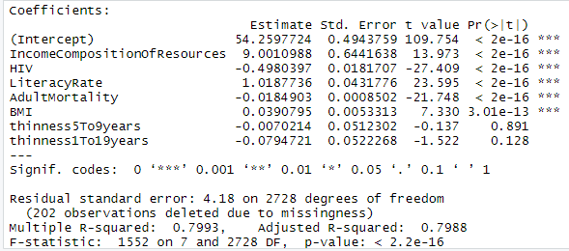
1) 80% variance in Life Expectancy is explained by variation in the 7 variables
(IncomeCompositionOfResources,HIV,LiteracyRate,AdultMortality,BMI,thinness5To9years &
thinness1To19years) and the rest 20% are unexplained variance.
2) p<0.05 for the 5 variables Income Composition Of Resources, HIV, Schooling, Adult Mortality & BMI means the 5 variables have a significant linear relation with the dependent variable Life Expectancy.
Now we will find how much percentage variance in Life Expectancy is explained by these 5 independent variables.
Income Composition Of Resources, HIV, Literacy Rate, Adult Mortality & BMI

Slide 9
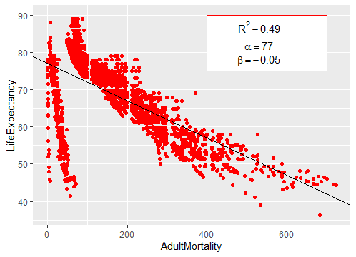
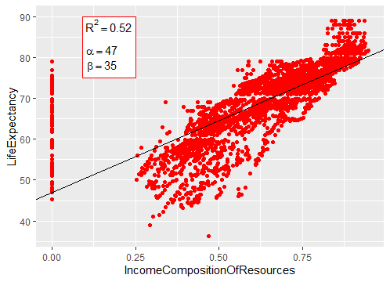
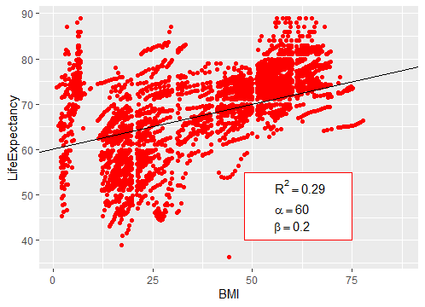
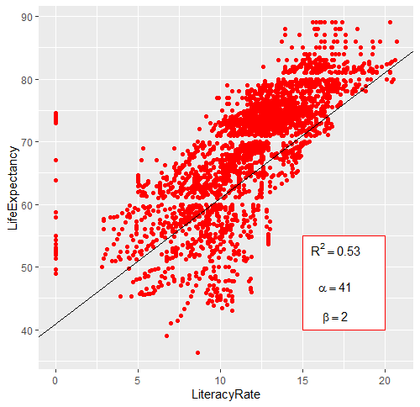
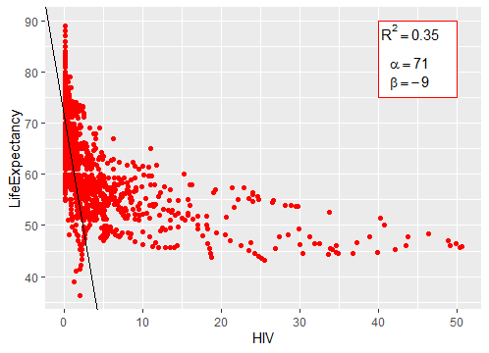

Slide 10
Residual Analysis

Slide 11
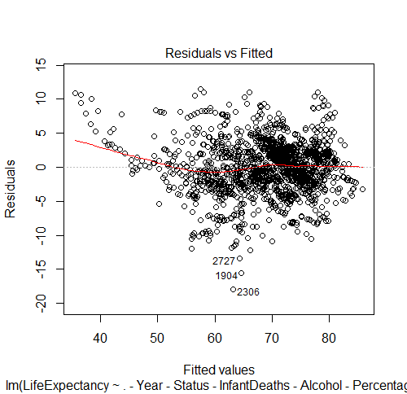
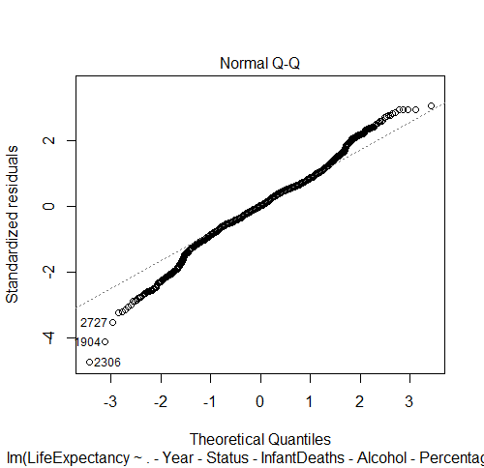
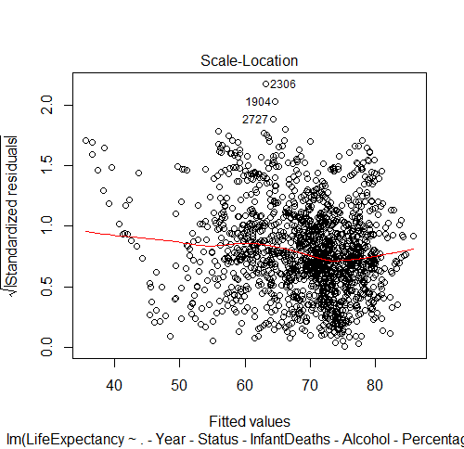
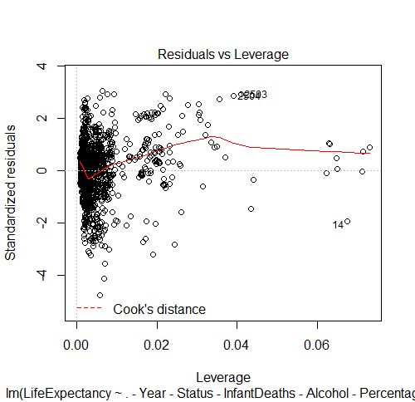
The Normal Q-Q plot shows equally spread residuals around a horizontal line with random pattern which indicate that there is no non-linear relationship in the regression model.
In the other 3 plots the residuals are not equally spread out.

Slide 12
VIF – Variance Inflation Factor
Income Composition Of Resources - 2.774723
HIV - 1.407718
Literacy Rate - 3.129025
Adult Mortality - 1.705367
BMI - 1.769541
Since for all the variables in the linear regression model VIF<10 hence multicollinearity does not exist between the variables.

Slide 13
From Linear Regression model we have found that Schooling, Income, Adult Mortality and HIV are the variables which have a strong linear relationship with Life Expectancy hence we will consider these 4 variables to explain the
“Factors influencing Life Expectancy in Developed and Developing countries from year 2000 to 2015”.

Slide 18
Graph Analysis:
1st Graph - Developed countries have high Literacy rate compared to Developing countries hence Life Expectancy is high in Developed countries.
2nd Graph – Developed countries have high income compared to Developing countries hence Life Expectancy is high in Developed countries.
3rd Graph – Adult Mortality for Developed countries is less than the Developing countries, which means that good health facilities and good standard of life increases the Life Expectancy in Developed countries.
4th Graph- HIV for Developed countries is much less than the Developing countries because of good health facilities.

Slide 19
Conclusion:
From the graphs it has been observed that in the past 15 years , there has been improvement of adult mortality rates, education and Income.
Predicting variables actually affecting the Life Expectancy are
a. Schooling
b. Income
c. Adult Mortality.
Countries having a lower Life Expectancy value should increase its healthcare and education expenditures.

